Slide 1

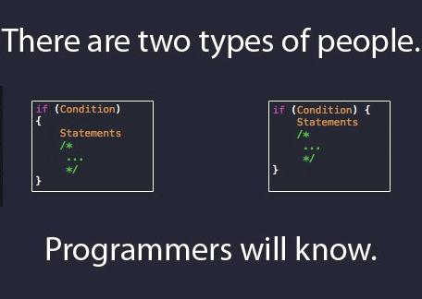
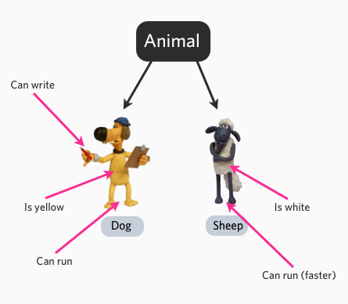
Java Object oriented programming
Dimitar Ivanov
Telerik Software Academy
Learning & Development
http://academy.telerik.com

Slide 2

Table of Contents
Procedural vs OOP
Class or Object
Class members
Class example
Fields - Declaration

Slide 3
Procedural vs Object Oriented Programming

Slide 4
Procedural vs OOP
The main unit in procedural programming is function, and unit in object-oriented programming is a class
Procedural programming concentrates on creating functions, while object-oriented programming starts from isolating the classes, and then follow the implementation of the methods inside of it.
Procedural programming separates the data of the program from the operations that manipulate the data, while object-oriented programming focus on both of them.
Notes:
Imperative programming for procedural

Slide 5
Class ? … Object ?
“Class” refers to a blueprint. It defines the variables and methods the objects support
“Object” is a instance of a class. Each object has a class which defines its data and behavior
Example:
LinuxConsole sudoBitch = new LinuxConsole();
sudoBitch.makeASandwitch();

Slide 6
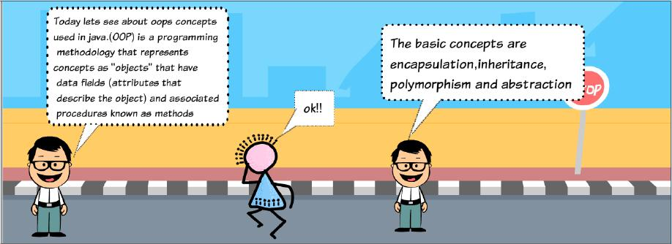
Class Members
One class can have up to three members :
Fields: data variables which determine the status of the class or an object
Methods: executable code of the class built from statements. It allows us to manipulate/change the state of an object or access the value of the data members
Nested classes and nested interfaces
Notes:
Give example about fields and methods

Slide 7
Class example
public class Book {
String color;
String title;
float price;
public static long nextID = 0;
public void setColor (String color) {
color = color;
}
}
Notes:
Access modifiers tell them about
Create class demo library
Write that this is just static demo and its not quality code

Slide 8
Fields - Declaration
Field Declaration
A type name followed by the field name, and optionally an initialization clause
Primitive data type vs. Object reference
Boolean, char, byte, short, int, long, float, double
Field declarations can be preceded by different modifiers
Access control modifiers
Static
Final

Slide 9
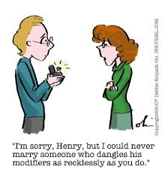
Fields - Declaration
Access control modifiers
private: private members are accessible only in the class itself
package: package members are accessible in classes in the same package and the class itself
protected: protected members are accessible in classes in the same package, in subclasses of the class, and in the class itself
public: public members are accessible anywhere the class is accessible

Slide 10

Fields - Declaration
Static
only one copy of the static field exists, shared by all objects of this class
can be accessed directly in the class itself
from outside the class, non-static fields must be accessed through an object reference

Slide 11
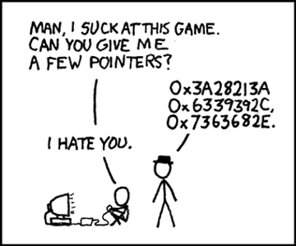
Fields - Declaration
Final
once initialized, the value cannot be changed
often be used to define named constants
static final fields must be initialized when the class is initialized
non-static final fields must be initialized when an object of the class is constructed
Notes:
Method overloading

Slide 12
Java Overview
http://academy.telerik.com

Slide 13




Free Trainings @ Telerik Academy
C# Programming @ Telerik Academy
csharpfundamentals.telerik.com
Telerik Software Academy
academy.telerik.com
Telerik Academy @ Facebook
facebook.com/TelerikAcademy
Telerik Software Academy Forums
forums.academy.telerik.com

